Slide 1
Department of Computer Science and Application
Atal Bihari Vajpayee University, Bilaspur, (C.G.)
Organizes
Two Days Workshop
On
“Ethical Hacking and Information Security”
7-8 December, 2022

Slide 2
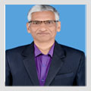
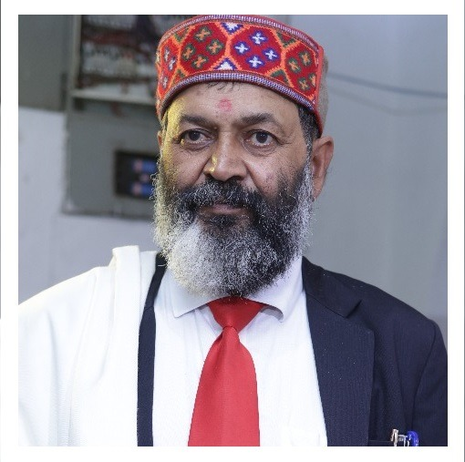
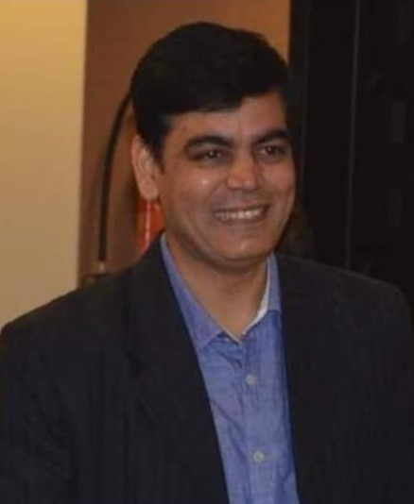
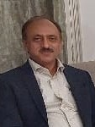
Inaugural Function 7th December, 2022
10:00 AM (IST)
Chief
Guest
Source of Inspiration
Dr. A.K. SAXENA
Professor and Head, Dept. of CSIT
Guru Ghasidas University, Bilaspur
Prof. A.D.N. Bajpai Hon’ble Vice-Chancellor, ABVV, BILASPUR
Special Guest
Special Guest
Dr. Abhishek Dubey
Head IS section, University of Technology and Applied Sciences, Salalah, Oman
Dr. Manoj Sood
Professor (Computer Science) Shimla University, HP

Slide 3
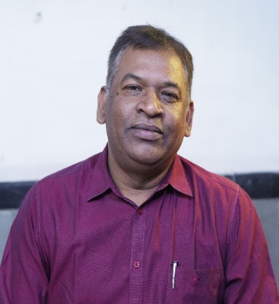
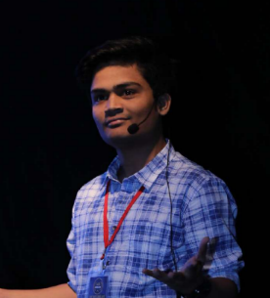
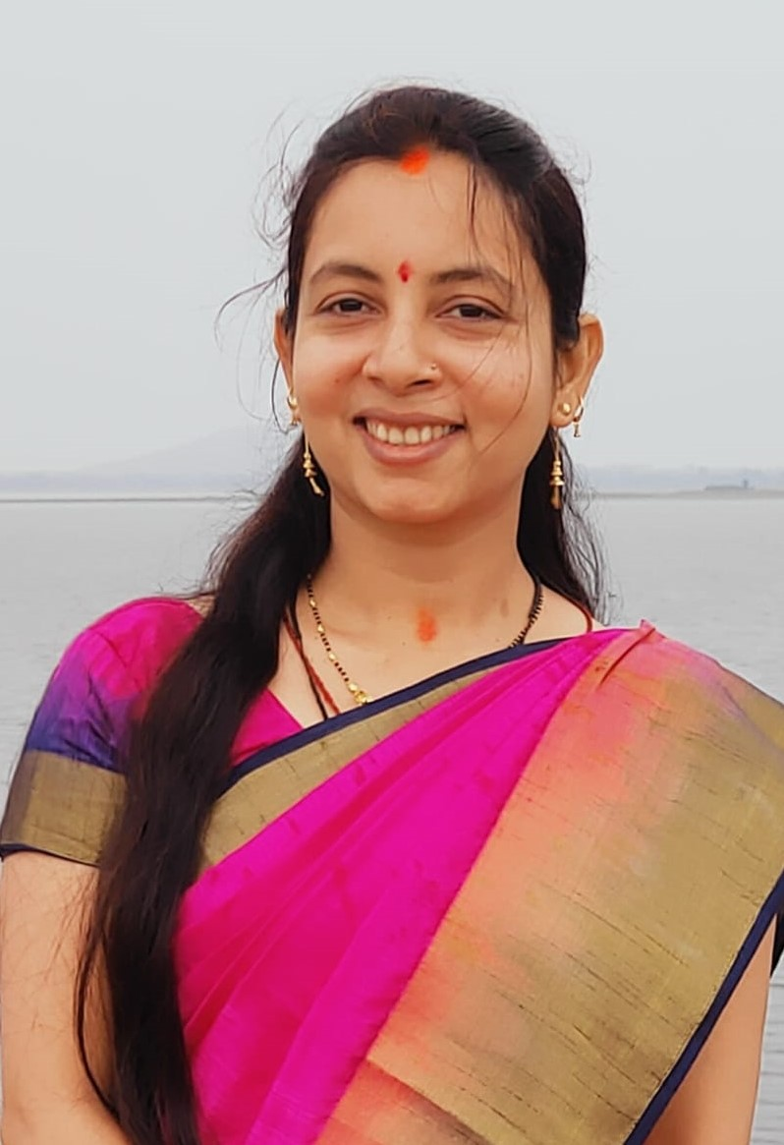
Inaugural Ceremony 7th December, 2022
10:00 am (IST)
Welcome Address and Opening
Remark
Expert
Mr. Ajinkya Lohakare CTO and Founder of Ditto Security, Mumbai
Dr. H.S. Hota
Professor and Head, Dept. of CSA, ABVV, Bilaspur
Vote of Thanks and Closing Remark
Mrs. Shriya Sahu Assistant Professor,
Dept. of CSA, ABVV, Bilaspur

Slide 4
Inaugural Function 7th December, 2022
10:00 am (IST)
TIME (IST) | Particular
10:00 AM | Opening Remark by Dr. H.S. Hota, Professor and Head, Department of CSA, Atal Bihari Vajpayee University, Bilaspur, C.G.
10:05 AM | Address by Special Guest: Dr. Abhishek Dubey, Head IS section, University of Technology and Applied Sciences, Salalah, Oman
10:10 AM | Address by Special Guest: Dr. Manoj Sood, Professor, Computer Science, Shimla University, HP, India
10:15 AM | Address by Chief Guest: Dr. A.K. Saxena, Guru Ghasidas University, Bilaspur, Chhattisgarh
10:25 AM | Vote of Thanks and Closing remark by Mrs. Shriya Sahu, Assistant Professor, Department of CSA, Atal Bihari Vajpayee University, Bilaspur, C.G.
10:30 AM | End of the Program

Slide 5
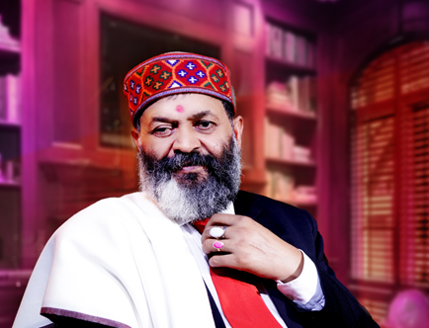
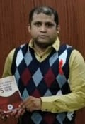
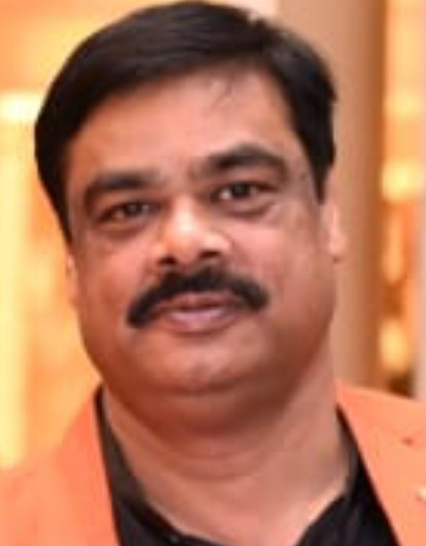
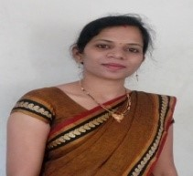
Valedictory Function 8th December, 2022
05:00 pm (IST)
Preside Over
Special Guest
Chief
Guest
Mr. Shailendra Dubey
Registrar, ABVV, Bilaspur,
C.G.
Prof. A.D.N. Bajpai Hon’ble Vice-Chancellor, ABVV, Bilaspur, C.G.
Welcome Address and Brief of workshop
Vote of Thanks
Dr. Manish Shrivastava
Guru Ghasidas University, Bilaspur, C.G.
Dr. Rashmi Gupta Assistant Professor, Dept of CSA, ABVV, Bilaspur, C.G.
Dr. H.S. Hota
Professor and Head, Dept of CSA, ABVV, Bilaspur ,C.G.

Slide 6
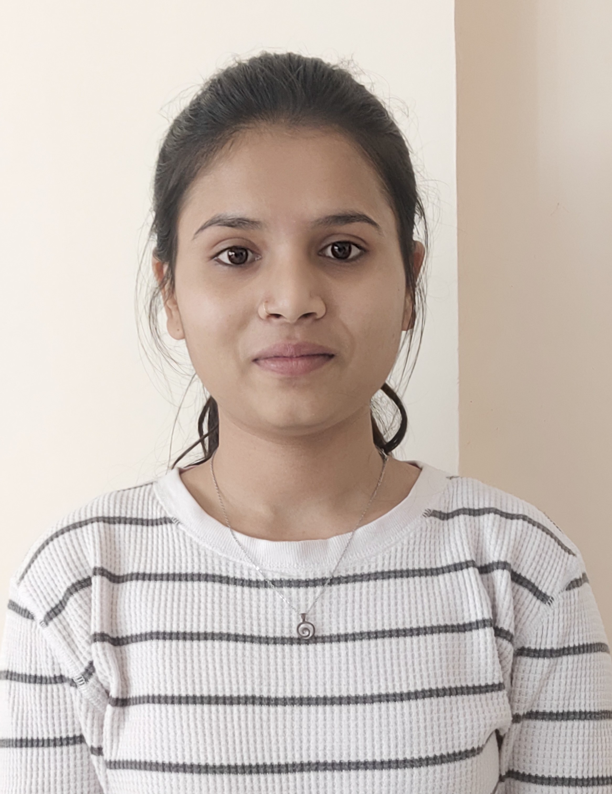
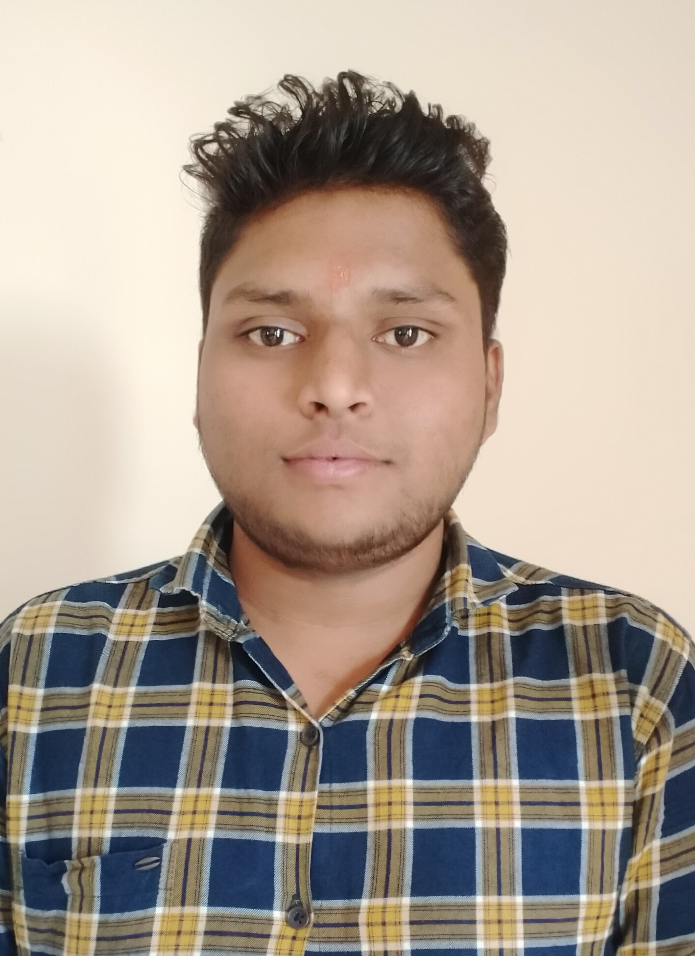
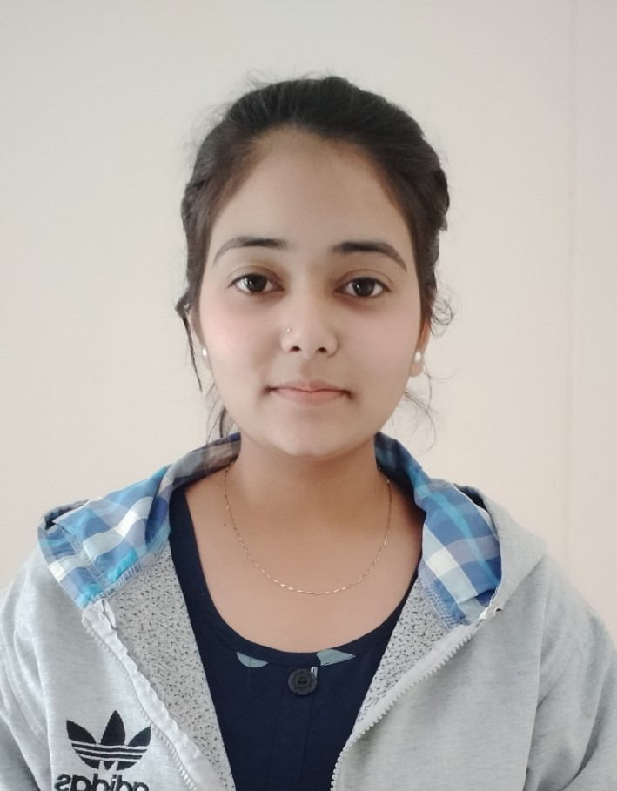
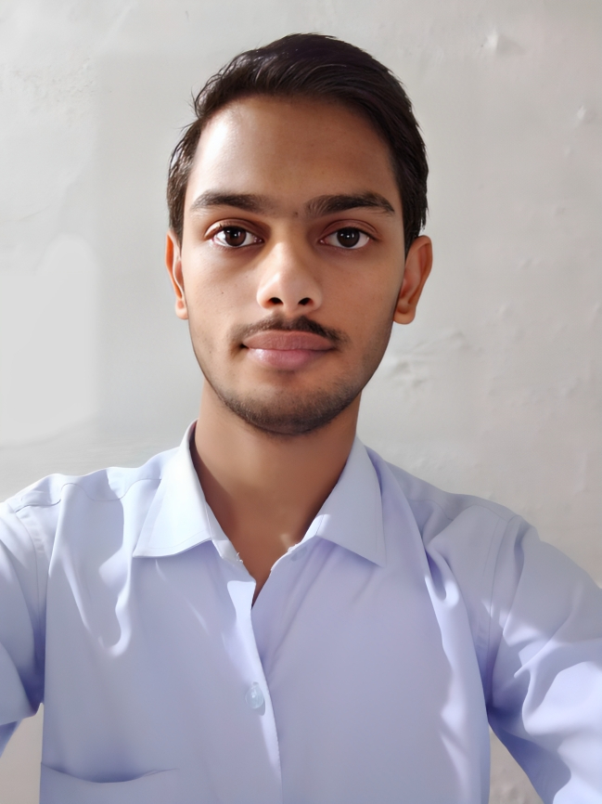
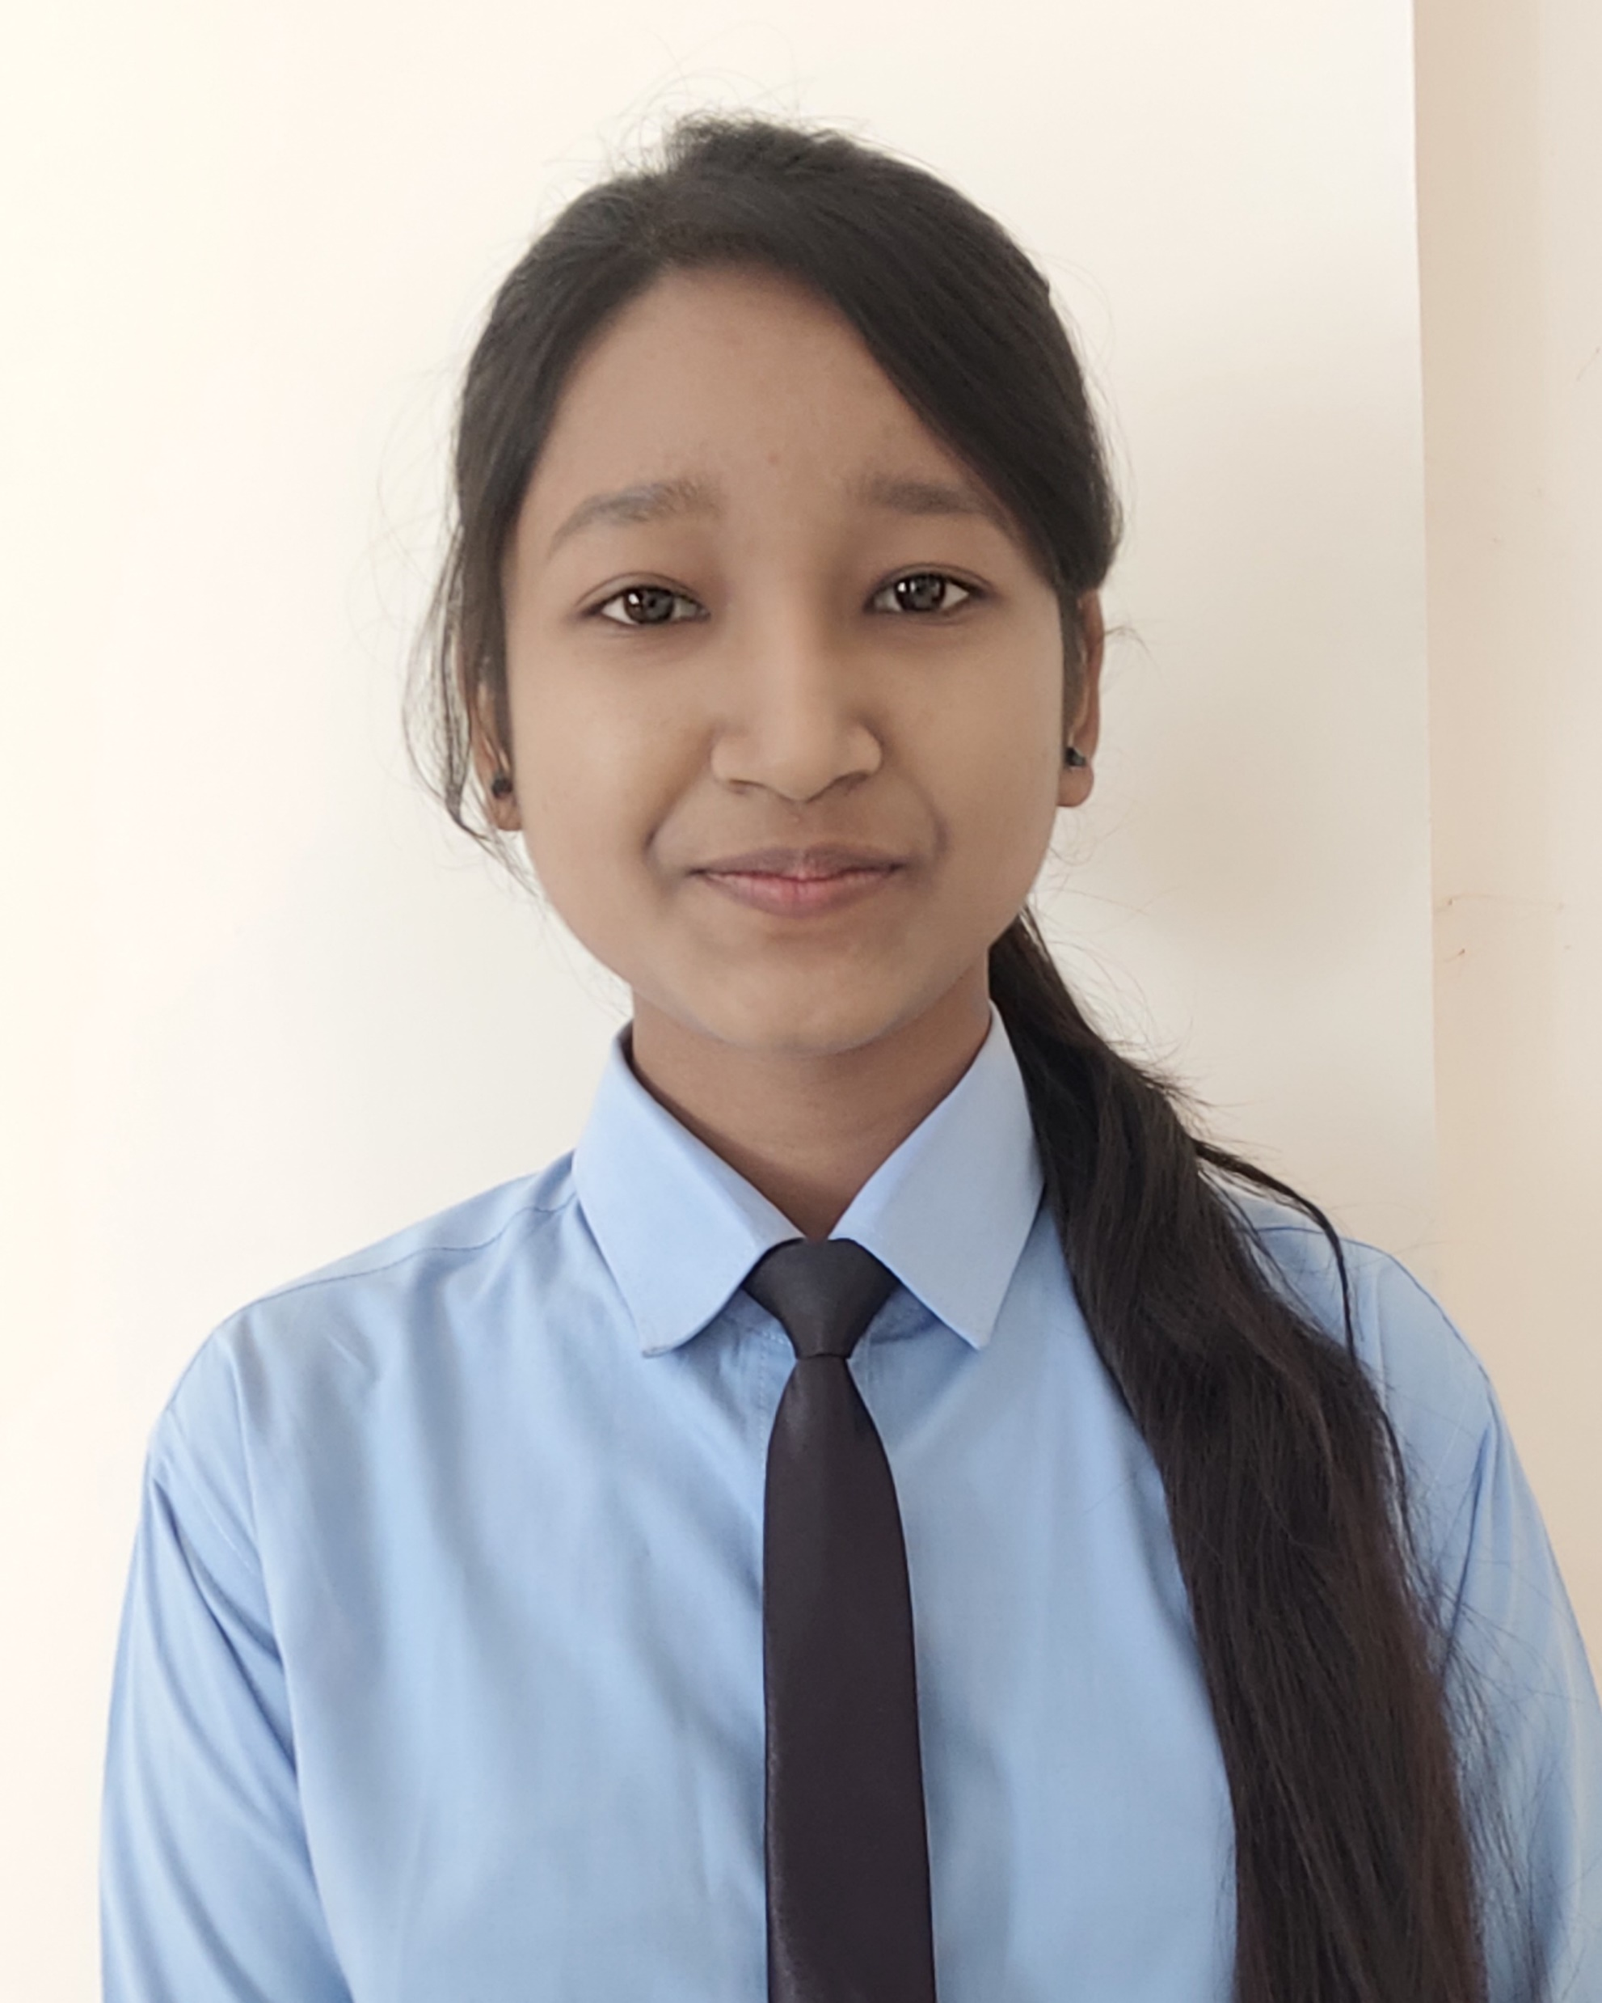
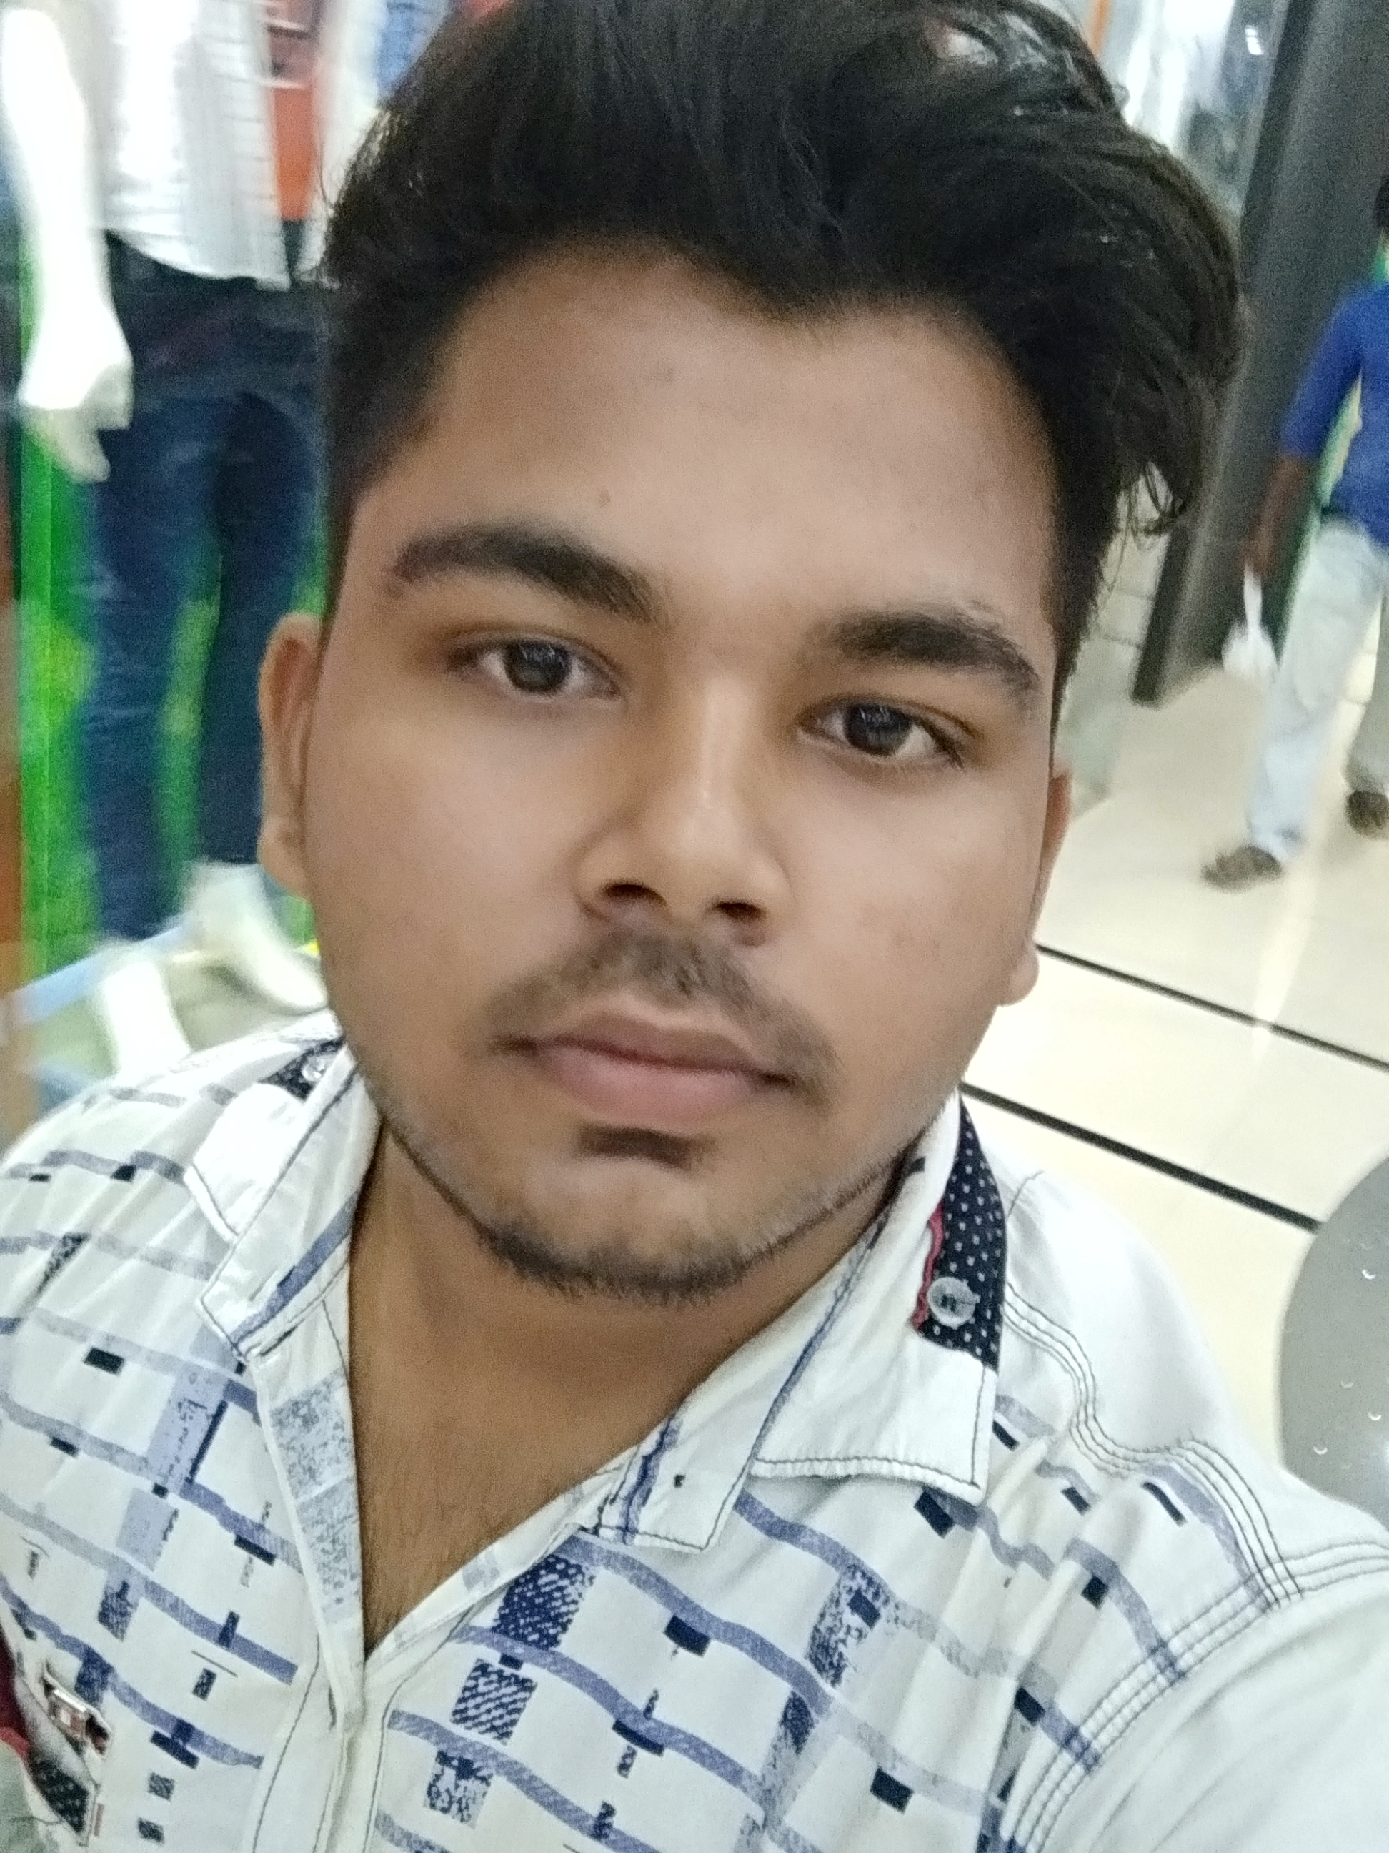
Valedictory Function 8th December, 2022
05:00 pm (IST)
Organizing Committee: Coding Club
Teacher Incharge
Members
Mrs. Shriya Sahu
Assistant Professor,
Dept. of CSA, ABVV, Bilaspur
DOL CHANDRA
MCA 1ST SEM
RAVEENA RAJAK
MCA 1ST SEM
ABHISHEK JAISWAL
M.SC 1ST SEM
BARAKHA SONI
M.SC 1ST SEM
AKHIL MISHRA
B.SC 1ST SEM
MUSKAN NIRMALKAR
B.SC 1ST SEM

Slide 7
Valedictory Function 8th December, 2022
05:00 pm (IST)
TIME (IST) | Particular
05:00 PM | Opening Remarks by Dr. H.S. Hota, Professor and Head, Department of CSA, Atal Bihari Vajpayee University, Bilaspur, C.G.
05:05 PM | Address by Special Guest: Dr. Manish Shrivastava, Guru Ghasidas University, Bilaspur, C.G.
05:10 PM | Address by Special Guest: Mr Shailendra Dubey Registrar, ABVV, Bilaspur, C.G.
05:15 PM | Feedback from the participants
05:25 PM | Presidential Address by Hon’ble Vice Chancellor Prof. A.D.N. Bajpai, Atal Bihari Vajpayee University, Bilaspur, C.G.
05:55 PM | Certificate Distribution
06:05 PM | Vote of Thanks and Closing Remark by Dr. Rashmi Gupta, Assistant Professor, Department of CSA, Atal Bihari Vajpayee University, Bilaspur
06:10 PM | End of the Program

